Slide 1

Smart Assistive Device For The Visually Challenged
Group No. 03
Student ID Student Name
16104030 Sameer Dev
16104016 Yogendra Kokamkar
16104015 Sudama Jaiswal
Project Guide: Prof. Kiran B. Deshpande

Slide 2
CONTENTS
Abstract
Introduction
Objectives
Literature Review
Problem Definition
Existing System Architecture/Working
Proposed System Architecture/Working
Technological Stack
Scope
Project Limitations
References

Slide 3
ABSTRACT
The World Health Organization (WHO) Fact reported that there are 285 million visually-impaired people worldwide. Among these individuals, there are 39 million who are blind in the world. Unfortunately, all these numbers are estimated to be doubled by 2020.
In this high tech era, technology has made it possible for everyone to live a comfortable life. But somehow the physically challenged people need to depend upon others in their daily life which ultimately makes them less confident in an unfamiliar environment.
So, in this project, an intelligent device is represented, which is an amalgamation of various technologies, for the visually challenged people to help them travel around the college and similar premises safely without facing any difficulties and needing human help.

Slide 4

PROBLEM DEFINITION
To create an assistive device for visually impaired people which will let them get a better sense of the surroundings and environment of our college and similar premises and also give them haptic and audio feedback regarding the obstacles. The device can also classify the nearby objects and give a basic idea to the user about the object either by voice commands or by haptic feedback. The device can be fully operated by voice commands for easy usage.

Slide 5
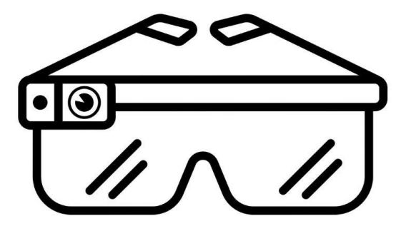
INTRODUCTION
In our project we present the modeling, implementation and testing of an experimental microcontroller (MCU) based smart assistive system which can be used by the visually impaired.
This device includes haptic and audio feedback options from which the user can select.
An easy-to-use Android App will also help the user set up the device during its first run or else the device will run using its default settings as it would be capable to work independently without requiring a smartphone to operate.

Slide 6
OBJECTIVES
Overcome Environmental Challenges
Overcome Social Challenges
Overcome Technological Challenges
Build a device for travelling safely around the campus

Slide 7
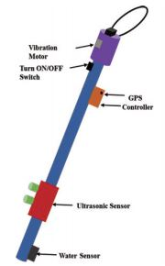
LITERATURE REVIEW
Paper Title : An intelligent walking stick for the visually challenged people.
Authors: Chang, Y.-H., Sahoo, N., & Lin, H.-W. (2018).
Publication Details: IEEE International Conference on Applied System Innovation 2018, IEEE ICASI 2018- Meen, Prior & Lam (Eds)
Findings: The system has experimented inside their campus and the result is that the obstacles are detected in time, the difference between the real and recorded distance varies only 2 to 3cm.
Advantages: Location Tracking.
Disadvantages: Cannot be used without the app. No Audio Feedback.

Slide 8
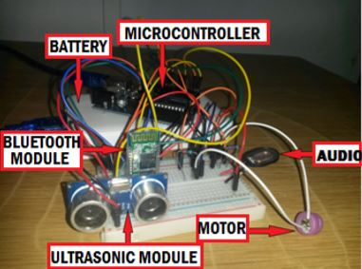
Paper Title : Voice-controlled smart assistive device for visually impaired individuals
Authors: Munteanu, D., & Ionel, R. (2016).
Publication Details: 2016 12th IEEE International Symposium on Electronics and Telecommunications (ISETC)
Findings: The most accurate results were obtained with flat surfaces as obstacles at an angle of maximum 30˚ from horizontal. Surfaces with irregular shapes can reflect the signals in the vicinity of the ultrasonic sensor and the results of the measurement can be erroneous. This shortcoming can be suppressed by moving the hand both in the horizontal and vertical planes.
Advantages: Ultrasonic Sensor can be configured with voice commands.
Disadvantages: Indicates only the distance of object, no other information about object.

Slide 9
Paper Title : Design and development of smart assistive device for visually impaired people.
Authors: Yadav, A. B., Bindal, L., Namhakumar, V. U., Namitha, K., & Harsha, H. (2016).
Publication Details : IEEE International Conference On Recent Trends In Electronics Information Communication Technology, May 20-21, 2016, India
Findings: Different objects were considered and the detection of their distances from the object were recorded. It is known that different colors have different absorptivity. Black is found to have the highest absorptivity and white the least. Due to this difference in absorptivity of light the range obtained for different colors vary.
Advantages: Variable Haptic Feedback.
Disadvantages: No proper identification of upfront object.

Slide 10
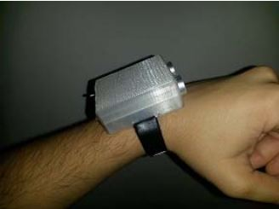
EXISTING SYSTEM ARCHITECTURE/WORKING
Intelligent Walking Stick (Figure 1)
The walking stick is based on sensors. The Ultrasonic sensor is used to detect the obstacles. As the bat get information about its prey by echolocation with the help of returned echoes of produced sound by itself, the same process has been applied to detect the obstacles.
Cons: Cannot be used without the app. No Audio Feedback or Maps Integration (Both the problems addressed by us in this project)
Smart Device for the Visually Impaired (Figure 2)
The device is a guiding mechanism that helps avoid collisions with obstacles present on the walking path. This work has been inspired from existing systems which are used by visually impaired and blind individuals on a daily basis.
Cons: Cannot be used without the app. No Audio Feedback or GPS Integration (Both the problems addressed by us in this project)
Figure 1
Figure 2

Slide 11
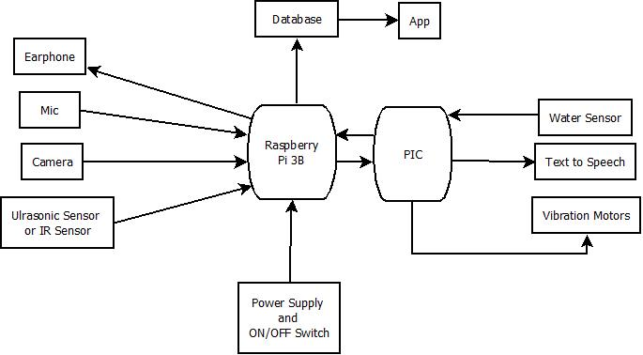
PROPOSED SYSTEM ARCHITECTURE/WORKING
The device is portable and the purpose of its usage is to warn the user when objects are present in the walking path so collision can be avoided and also guide the user in the right directions while walking.
Distance measurements, between the user and possible obstacles, and object detection are performed using Machine Learning models based on Convolution Neural Networks (CNN) using OpenCV and also ultrasonic echolocation and the data provided by the modules is processed by a microcontroller, which also handles the audio and haptic feedback part.

Slide 12
POSSIBLE FUTURE ADDITIONS
We plan to integrate Google Maps API after the successful completion and testing of our initial proposed system so that users can also use this device outside college boundaries
The Maps API integration will allow us to design a system where the user can be made aware about all the information that is available while using the Navigation feature of Maps such as weather, orientation, direction to take, etc.
The primary language currently is English but we also plan to add language support for Hindi and Marathi

Slide 13
TECHNOLOGY STACK
Software:
Python
OpenCV
Keras/TensorFlow
MySQL
Android Studio
Hardware:
Raspberry Pi 3B
Pi Camera
PIC
Ultrasonic Sensor
Water Sensor
Vibration Motor
GPS Module

Slide 14
SCOPE
It will make the use of various technologies in order to create a single device capable of assisting the huge number of people in need.
The device will be making real time predictions without any human help, it will be an added benefit as the people using this device will be able to walk around the campus without any external human help.

Slide 15
PROJECT LIMITATIONS
Integration of so many modules with a single Raspberry PI could slow down performance. Effective solution has to be developed.
Object Detection Model has to be trained extensively on private datasets to enable it to detect common objects found in college campus.
The Raspberry PI board has to be powered with the help of a battery hence the whole system needs to be energy efficient in order to run for a longer time.

Slide 16
REFERENCES
[1] https://ieeexplore.ieee.org/document/8394480
Chang, Y.-H., Sahoo, N., & Lin, H.-W. (2018). An intelligent walking stick for the visually challenged people. 2018 IEEE International Conference on Applied System Invention (ICASI)
[2] https://ieeexplore.ieee.org/document/7808083
Yadav, A. B., Bindal, L., Namhakumar, V. U., Namitha, K., & Harsha, H. (2016). Design and development of smart assistive device for visually impaired people. 2016 IEEE International Conference on Recent Trends in Electronics, Information & Communication Technology (RTEICT)
[3] https://ieeexplore.ieee.org/document/7781087
Munteanu, D., & Ionel, R. (2016). Voice-controlled smart assistive device for visually impaired individuals. 2016 12th IEEE International Symposium on Electronics and Telecommunications (ISETC)

Slide 17
Thank You...!!

